Slide 1

FutureTech - Hiring Strategy
Prepared by
Fausto Lira
Anslem Okeke

Slide 2

Agenda
FutureTech
Hiring Process
Outcomes
Programs: ABXL, ARC, EMA, REP, and QB
Final Considerations

Slide 3


FutureTech
Over 15 years of experience in analytics consulting.
Diversity matches our company's key beliefs in innovation, inclusion, and respect.

Slide 4

Hiring Process
Implemented 5 different hiring programs: ABXL, ARC, EMA, REP, and QB.
The target for new employees: 25% women and 40% diversity group.
Five ethnically diverse candidates reneged on their offers.

Slide 5
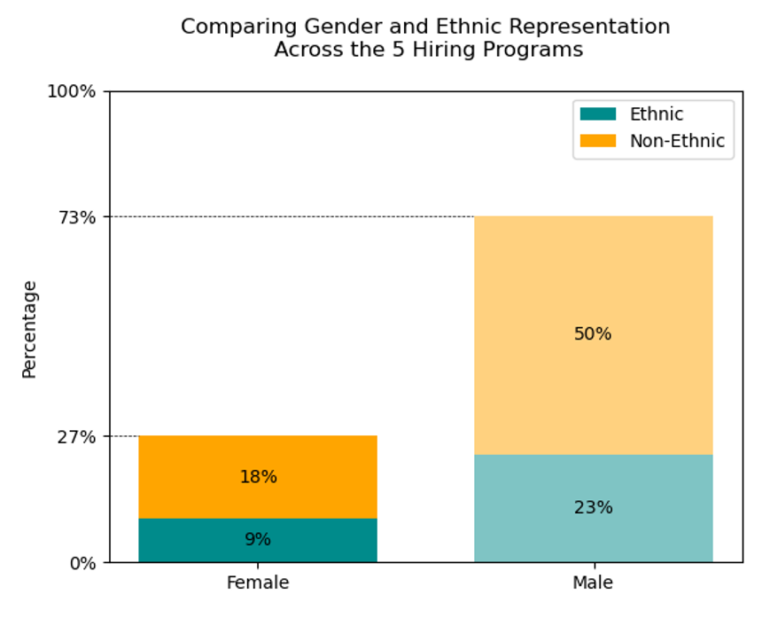
Outcomes
OUTCOMES
Achieved 27% of female hiring
50% of jobs filled by diversity candidates

Slide 6
Programs: ABXL, ARC, EMA, REP, and QB
Out of all available positions, were allocated 50% to the diversity group.
ARC hiring program achieves 41% of diversity.

Slide 7

Final Considerations
Conclusions
All five hiring programs were highly successful
Positive feedback from candidates
Improvement in diversity group ratio
Better adaptation to global markets
Recommendations
Keep the initiative
Diversity in the hiring staff
Feedback from ethnically diverse candidates who declined the offer
Review the process for improvement

Slide 8

THANK YOU

